Slide 1
CS 367 Introduction to Data Structures
Lecture 20

Slide 2
Today’s topics:
Quick Sort
Heap Sort
Radix Sort
Bucket Sort

Slide 3
Quick Sort
A divide & conquer sort
Partitions array into two parts, and
Recursively sorts both
But no merge phase is needed!

Slide 4
We start by partitioning the array into two pieces:
“small values” on the left
and “large values” on the right.
The two pieces are recursively sorted.
Nothing more need be done!

Slide 5
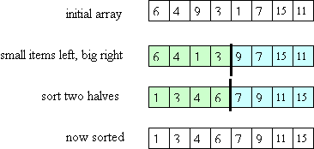

Slide 6
How do we Partition the Array?
We choose a pivot value:
All values less than pivot go to left partition.
All values greater than pivot go to the right partition.
Equal values can go in either partition.

Slide 7
Outline of Quick Sort
Choose a pivot value.
Partition the array:
Put all values less than the pivot in the left part of the array, then the pivot itself, then all values greater than the pivot. (Copies of the pivot value can go in either part of the array.)
Recursively, sort the values less than (or equal to) the pivot.
Recursively, sort the values greater than (or equal to) the pivot.

Slide 8
A few details
We represent array partitions as a reference to the whole array plus low and high indices.
The base case isn’t a partition of size one. Instead we stop at small partitions (size 20 or so) and use a simple sort.

Slide 9
How to choose the Pivot
The median would be ideal – but how do we compute it without sorting?
Choosing a random value in the array might work, but how do we get a fast & accurate random value?
Early version of quick sort just took the first (leftmost) value, but this fails badly for sorted values:

Slide 10
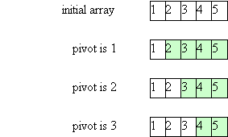

Slide 11
Median of 3 Pivot
Choose the median of the 3 values: A[low], A[high], and A[(low+high)/2].
(Requires partition size of at least 3)

Slide 12
Forming the Partition
Of the 3 values, smallest goes into A[low].
Largest goes into A[high]
Pivot is swapped with value in A[high-1].
Now two pointers move through the array:
Left starts at left end and moves right until a value greater than pivot is found.

Slide 13
Right pointer starts at right end and moves left, looking for a value less than pivot.
This continues until either the left and right pointers cross or two “out of position” values are found.
If the pointers cross we are essentially done.
Otherwise, the two out-of-position values are swapped, and the two pointers start moving again.

Slide 14
Here is the detailed outline of the sort:
Choose the pivot (using the "median-of-three" technique);
Put the smallest of the 3 values in A[low], put the largest of the 3 values in A[high], and swap the pivot with the value in A[high-1].
Initialize: left = low+1; right = high-2

Slide 15
Use a loop with the condition:
while (left <= right)
The loop invariant is:
all items in A[low] to A[left-1] are <= the pivot
all items in A[right+1] to A[high] are >= the pivot

Slide 16
Each time around the loop:
left is incremented until it "points" to a value > the pivot
right is decremented until it "points" to a value < the pivot
if left and right have not crossed each other,
then swap the items they "point" to.
4. Put the pivot into its final place.

Slide 17
private static <E extends Comparable<E>>
int partition(E[] A, int low, int high) {
// precondition: A.length > 3
E pivot = medianOfThree(A, low, high); // step 1
int left = low+1; right = high-2;
while ( left <= right ) {
while (A[left].compareTo(pivot) < 0) left++;
while (A[right].compareTo(pivot) > 0) right--;
if (left <= right) {
swap(A, left, right);
left++;
right--;
}
}

Slide 18
swap(A, right+1, high-1);
// step 4
return right;
}

Slide 19
public static <E extends Comparable<E>> void quickSort(E[] A) {
quickAux(A, 0, A.length-1);
}
private static <E extends Comparable<E>> void quickAux(E[] A, int low, int high) {
if (high-low < 4) insertionSort(A, low, high);
else {
int right = partition(A, low, high);
quickAux(A, low, right);
quickAux(A, right+2, high);
}

Slide 20
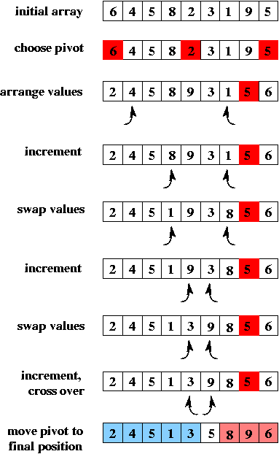

Slide 22
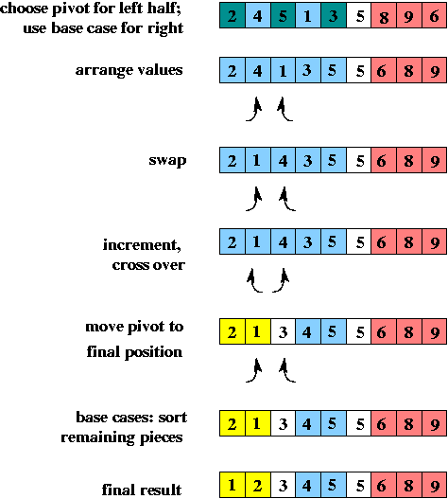

Slide 24
Complexity of Quick Sort
What is the time for quick sort?
If the pivot is always the median value, then the calls form a balanced binary tree (like they do for merge sort).
In the worst case (the pivot is the smallest or largest value) the calls form a "linear" tree.
In any case, the total work done at each level of the call tree is O(N) for partitioning.

Slide 25
So the total time is:
worst-case: O(N²)
in practice: O(N log N)
Quick sort's worst-case time is worse than merge sort's. However, an advantage of quick sort is that it does not require extra storage, as merge sort does.

Slide 26
What if array is already sorted?
When the array is already sorted, quick sort takes O(N log N) time,
(assuming that the "median-of-three" method is used to choose the pivot.)
The pivot will always be the median value, so the two recursive calls will be made using arrays of half size. The calls will form a balanced binary tree.

Slide 27
Heap Sort
We used the heap data structure to implement priority queues.
We can use the same structure to sort an array.
The idea is simple – enter all data into a heap, then remove the highest values one by one. We fill the array from right to left.

Slide 28
N insertions take O(N log N) time.
N removals also take O(N log N).
But we can do even better!
We can let the heap data structure share space with the original array.
Moreover, using an operation called heapify, we can build and fill the heap in O(N) time.
(Removing data to complete the sort still takes O(N log N) time.)

Slide 29
The approach is clever.
To start, the unsorted data fills the entire array.
The data are reorganized into a heap (using heapify).
The root is the largest value. It is swapped with the rightmost heap value. The highest array value is now in place.
We reestablish a valid heap and select the root. It is swapped with the rightmost heap value.

Slide 30
Now the second largest value is in the correct location (next to last in the array).
We repeat the process until the entire array is placed in correct order.

Slide 31
Heapify
We’ll view the heap as a tree though it actually maps to array positions (in level order).

Slide 32
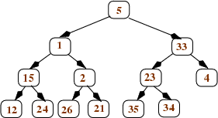
Thus in
value 5 is in the leftmost array position, followed by 1, then 33, and ending with 34.

Slide 33
Heapify works bottom-up, turning sub-trees into mini-heaps.
Start with nodes that are parents of leaves.
We compare each node n with its two children (which are leaves).
We swap n with the larger child, as necessary.

Slide 34
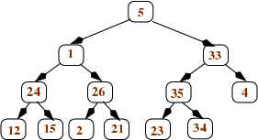
Staring with
we get

Slide 35
We now examine nodes n one level up in the tree.
These nodes have two children, and each is already in heap form.
We again compare a node n with its children and swap the bigger into the root as necessary.
The swapped value is compared with its new children and swap again, until correct heaps are established.

Slide 36
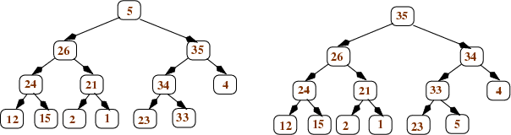
becomes

Slide 37
Then the root is processed:

Slide 38
Cost of Heapify
One half of the nodes are leaves at the bottom the of tree.
They take 1 comparison with their parent to process.
One quarter of the leaves are at height 2 and takes at most two comparisons to process.

Slide 39
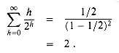
The total time is then
N * (1/2*1 + ¼*2 + 1/8 * 3 + 1/16 * 4 ...)
Now
So heapify is O(N) – linear!

Slide 40
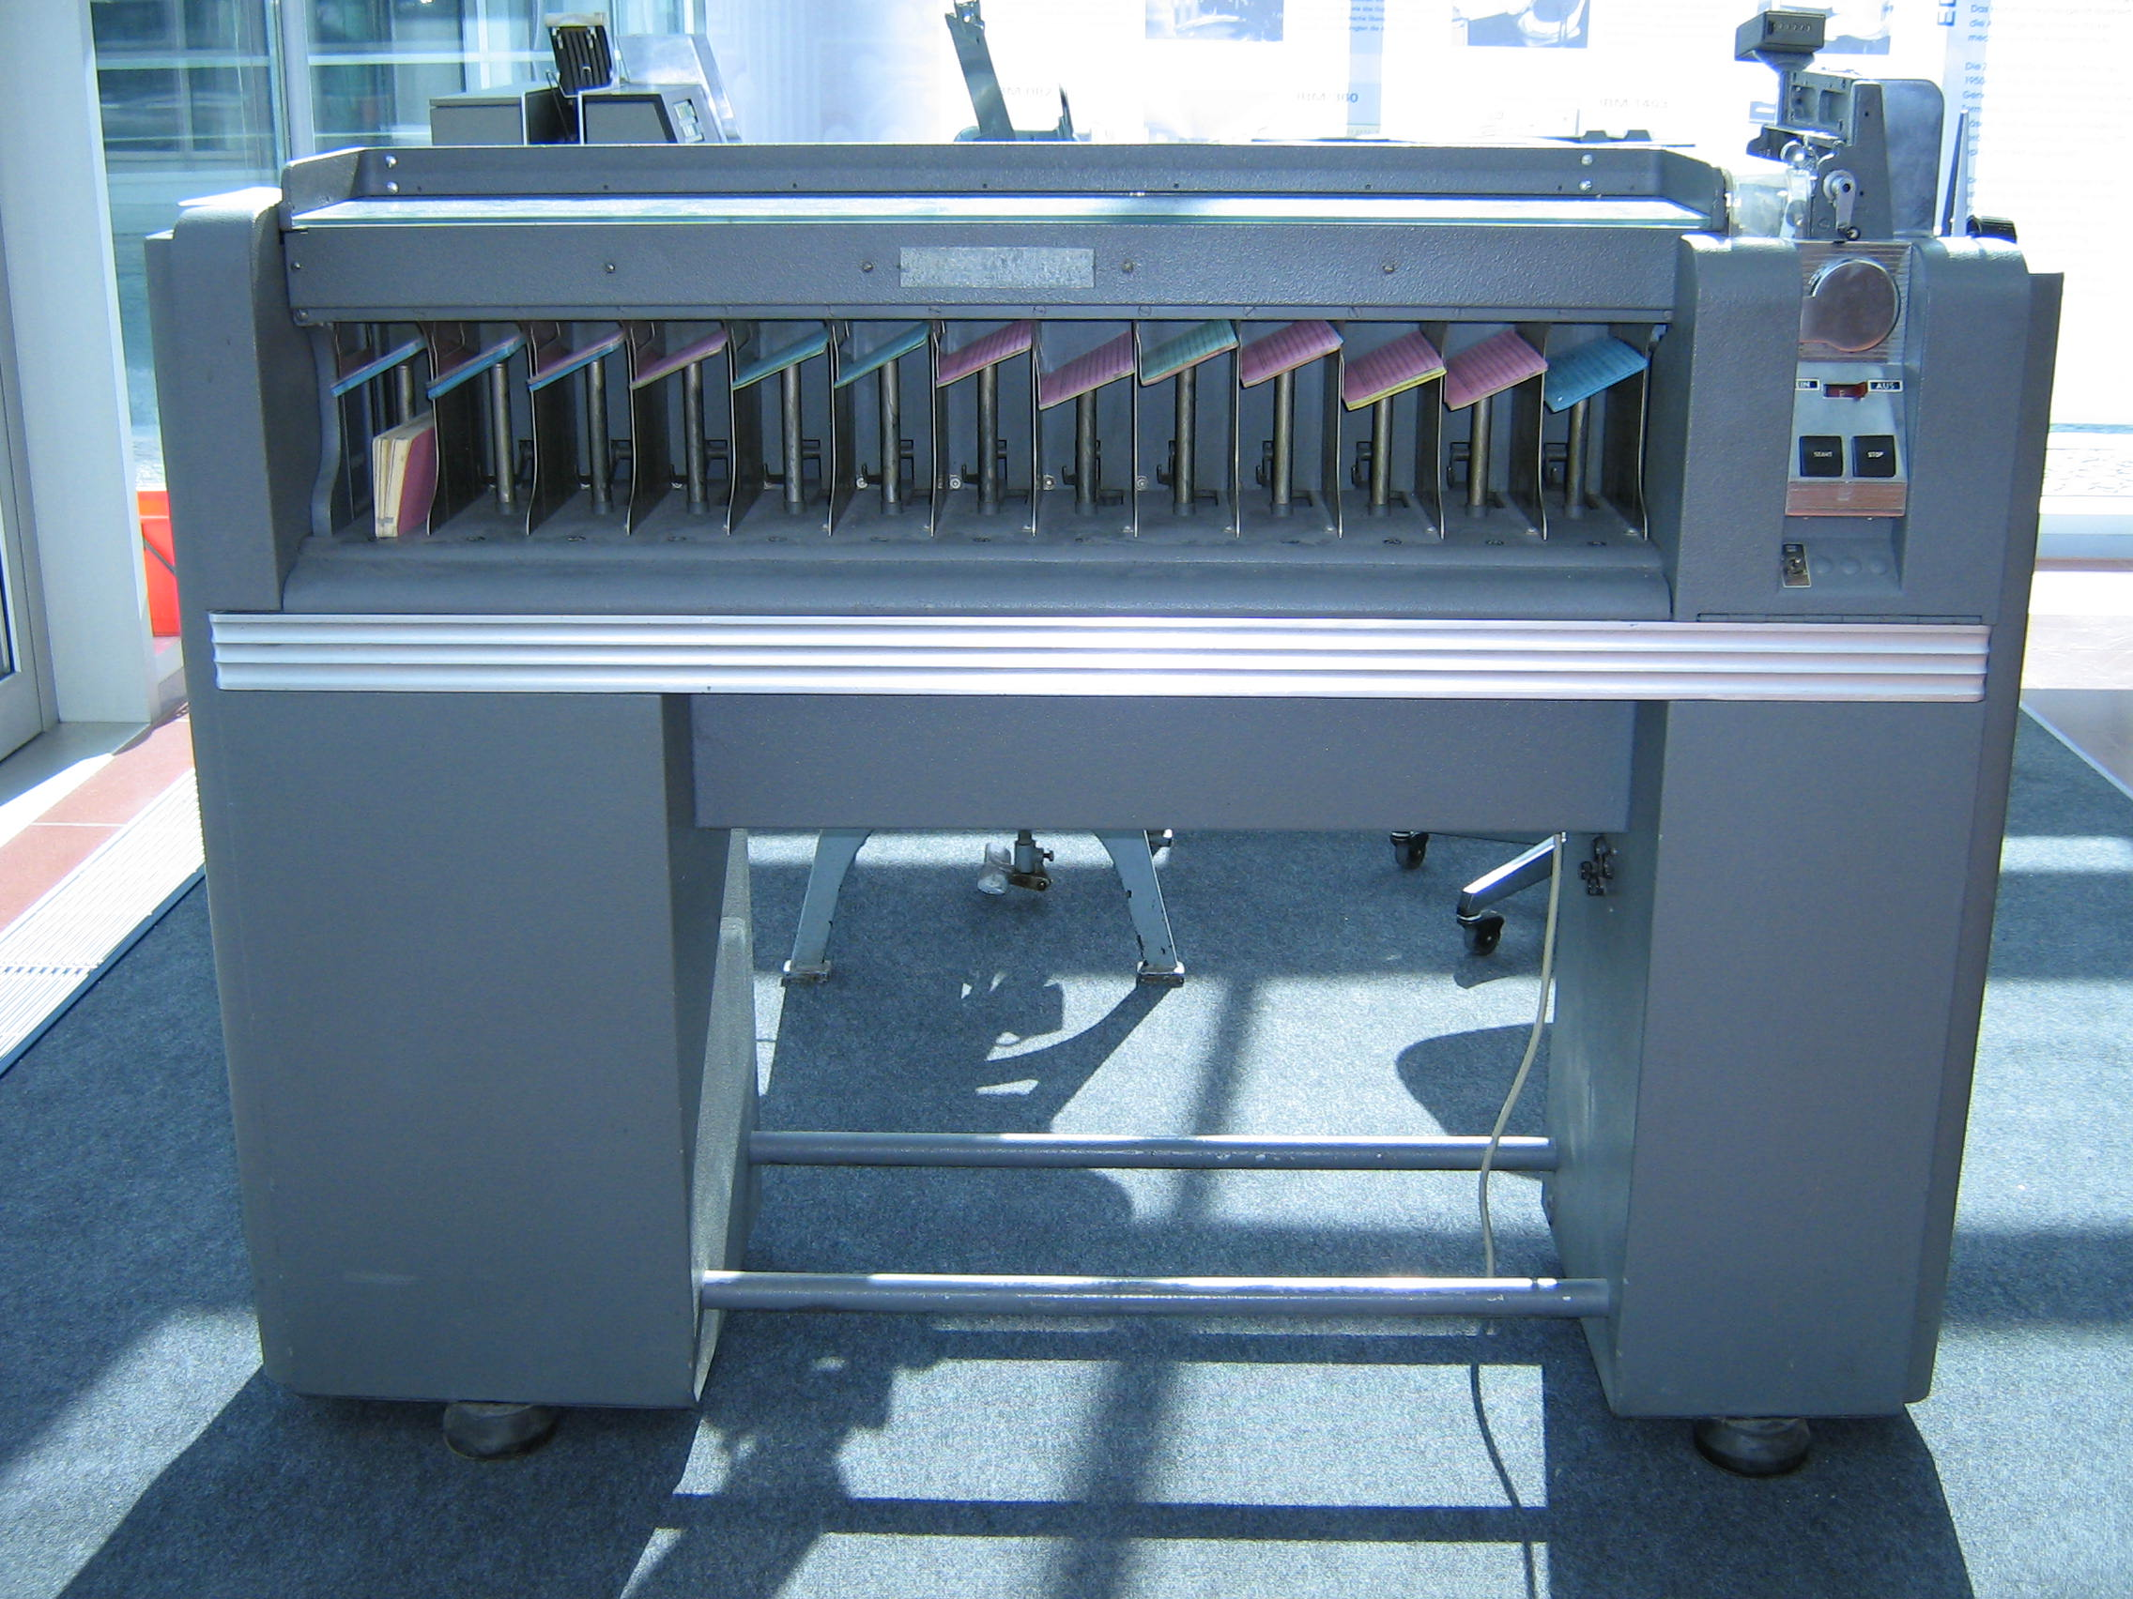
Radix Sort

Slide 41
All the sorts we’ve studied are comparison sorts.
It can be proven that in the worst case a comparison sort must take at least O(N log N).
Sorts that don’t do direct comparisons can be faster.
A Radix Sort is such a sort.

Slide 42
A radix sort works by comparing items character by character (or digit by digit).
If range is the range of individual values
(typically 10 or 26) and
len is the maximum length of items to be sorted, then a radix sort requires
O((N + range) * len) time.

Slide 43
Thus sorting 100 four digit integers takes (100+10)*4 = 440 operations.
Sorting 1000 10 character words (lower-case only) takes (1000 +26) * 10 = 10,260.

Slide 44
Idea behind Radix Sort
We sort items character by character, right to left (least significant to most significant).
After one pass, the items are sorted with respect to the rightmost character.
After 2 passes, items are sorted acording to the last two characters.
After len passes, items are fully sorted.

Slide 45
As items are examined at a particular character position, items are placed in a queue based on the character value.
Then items are dequeued back into the array and the next character position is examined.

Slide 46
Example of Radix Sort
Assume we start with
[132, 355, 104, 327, 111, 285, 391, 543, 123, 535]
Here N = 10, range = 10 and len = 3.
We examine the rightmost digit and place each number in one of 10 queues:

Slide 47
0:
1: 111, 391
2: 132
3: 543, 123
4: 104
5: 355, 285, 535
6:
7: 327
8:
9:

Slide 48
We empty each of the 10 queues into the original array:
[111, 391, 132, 543, 123, 104, 355, 285, 535, 327]
Now we look at the second to last digit,
and refill the 10 queues:

Slide 49
0: 104
1: 111
2: 123, 327
3: 132, 535
4: 543
5: 355
6:
7:
8: 285
9: 391

Slide 50
We again empty each of the 10 queues into the original array:
[104, 111, 123, 327, 132, 535, 543, 355, 285, 391]
We finally look at the last (leftmost) digit,
and refill the 10 queues:

Slide 51
0:
1: 104, 111, 123, 132
2: 285
3: 327, 355, 391
4:
5: 535, 543
6:
7:
8:
9:

Slide 52
When we empty each of the 10 queues into the original array, we have a complete sort:
[104, 111, 123, 132, 285, 327, 355, 391, 535, 543]

Slide 53
Complexity of Radix Sort
Each pass of a radix sort takes O(N) time to fill the queues and O(N + range) time to put partially sorted values back into the input array.
The number of passes is equal to len,
so O((N + range) * len) time is needed.

Slide 54
When is Radix Sort Worthwhile?
The best comparison sorts are O(N log N).
Radix sort is O((N + range) * len) .
Since range is usually much small than N,
radix sort is better if len < log N.
For example, some 56,000,000 people receive Social Security benefits.

Slide 55
Log₂ of 56,000,000 is 25.74.
So a radix sort can be expected to beat an N log N sort by a factor of 25.74/9.
Almost 3 times better!

Slide 56
Bucket Sort
In the case that items are to be sorted into a limited number of positions, a bucket sort is useful.
If an item can be placed into one of k categories, we create k different bags.
We examine each item and place it in the proper bag.
We then visit each bag and collect its contents.

Slide 57
For example, if a company decides to recognize employees on their birthday, we’d create 366 bags.
Then we’d visit each employee record and place the employee’s name in the bag corresponding to the recorded birthday.
If we have N items and k categories,
total time is O(N + k).
Often k is much smaller than N, making the sort effectively linear!

Slide 58
Sorting Summary
Selection Sort:
N passes. On pass k: find the k-th smallest item, put it in its final place
Always O(N²)

Slide 59
Insertion Sort:
N passes, on pass k: insert the k-th item into its proper position relative to the items to its left
worst-case O(N²)
given an already-sorted array: O(N)

Slide 60
Merge Sort:
recursively sort the first N/2 items, recursively sort the last N/2 items, merge (using an auxiliary array)
always O(N log N)

Slide 61
Quick Sort:
choose a pivot value partition the array:
left part has items <= pivot
right part has items >= pivot recursively sort the left part recursively sort the right part
worst-case O(N²)
expected O(N log N)

Slide 62
Heap Sort:
use heapify to convert the unsorted array into a heap, then do N removeMax operations. Each operation frees one more space at the end of the array; put the returned max value into that space.
always O(N log N)

Slide 63
Radix Sort:
make len passes through the N sequences to be sorted, right-to-left on each pass, put the values into the queue in position p of the auxiliary array, where p is the value of the current "digit" then put the values back from the auxiliary array into the original array
no comparisons of values are done (i.e., radix sort is not a comparison sort).
always O(N + range) * len)

Slide 64
Bucket Sort:
Map each item into one of k buckets
no comparisons of values are done (not a comparison sort).
always O(N + k)

